Slide 1
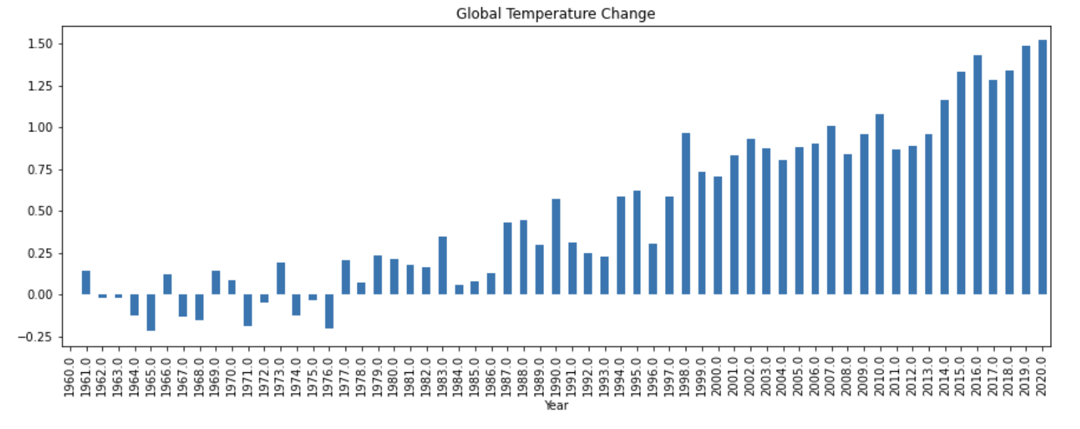
Executive Summary: Carbon emissions are driving a global increase in temperatures, and if current emission trends continue, temperatures will rise as much as 5 degrees Celsius over the next 100 years.

Slide 2
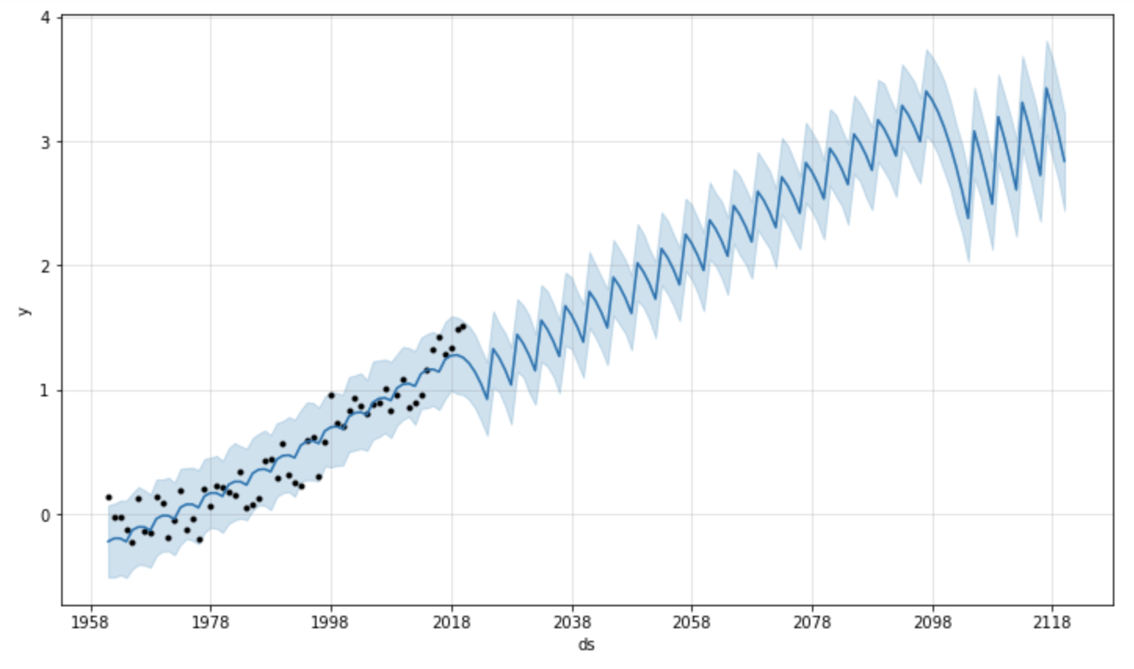
Predictive modeling based on the past 60 years of temperature data shows the temperature will continue to increase, reaching over 3.4 degrees Celsius above normal in 2116.

Slide 3
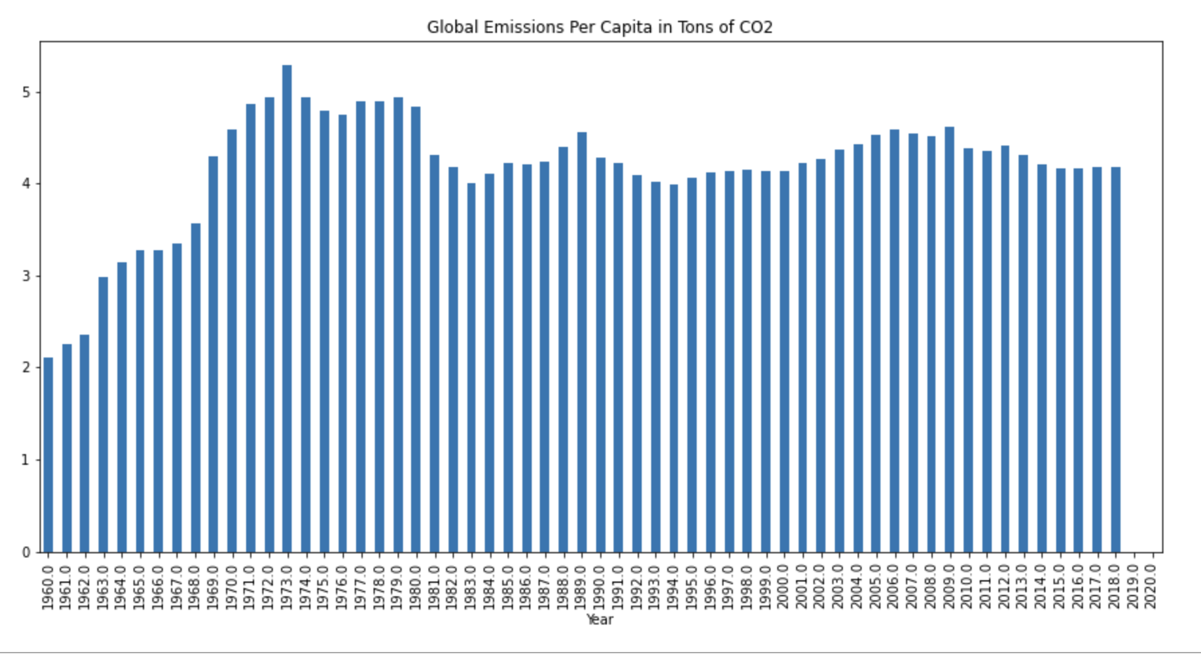
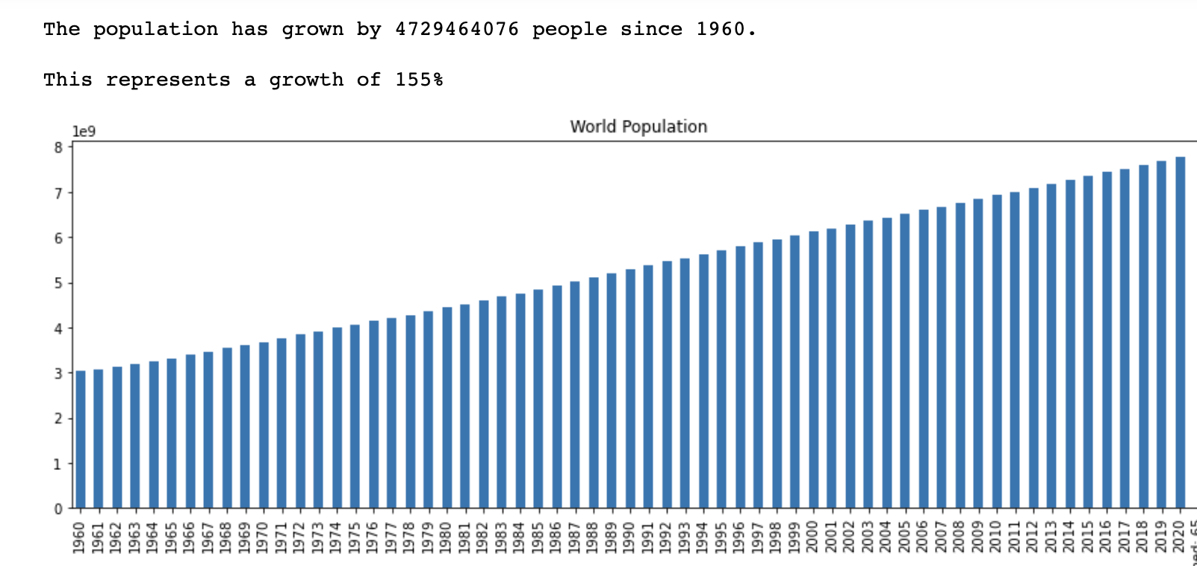
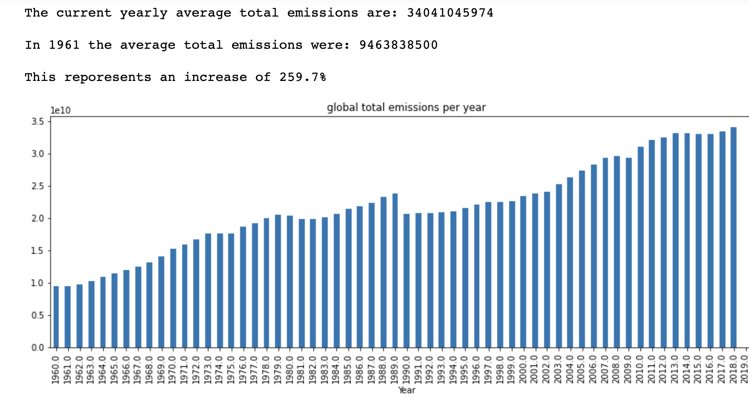
Per capita emissions have leveled off global, but with a growing population, total emissions have risen.

Slide 4
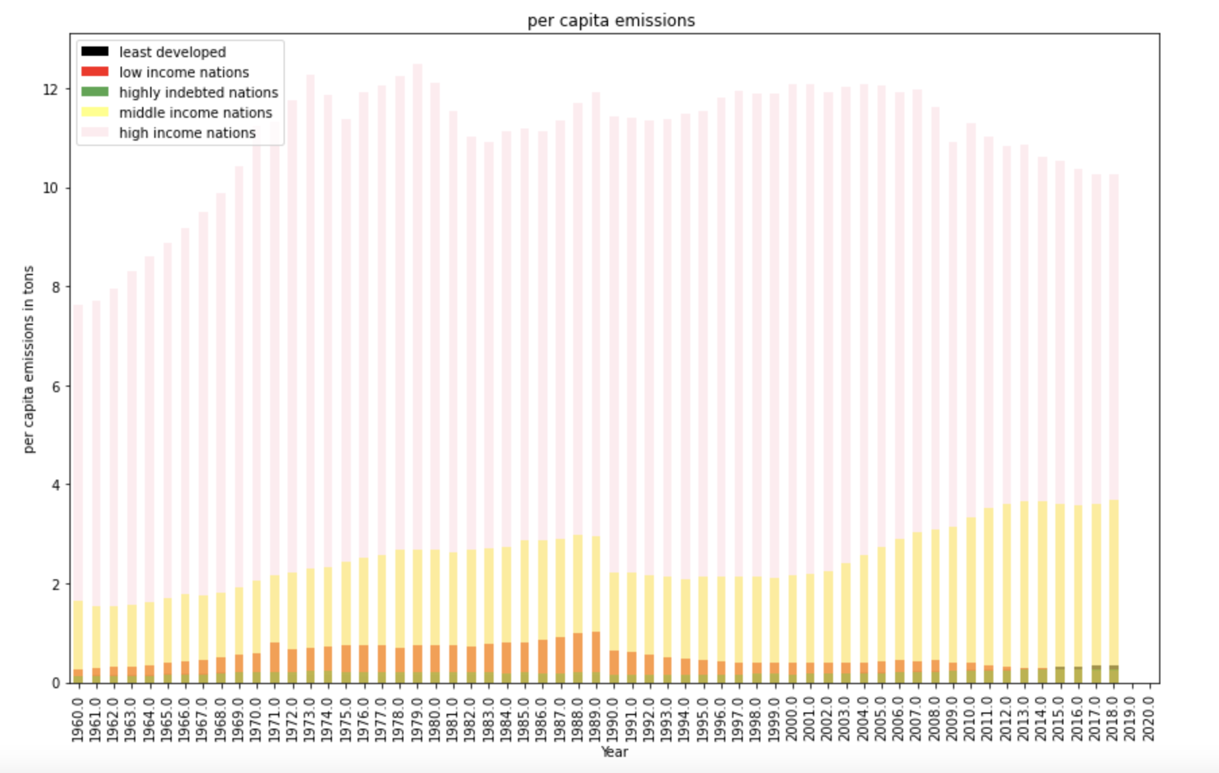
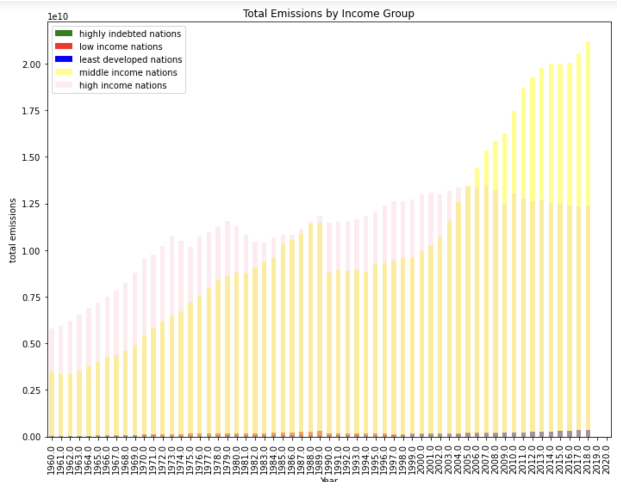
However, it is primarily wealthy nations, and, increasingly, middle-income nations contributing to CO2 emissions.

Slide 5
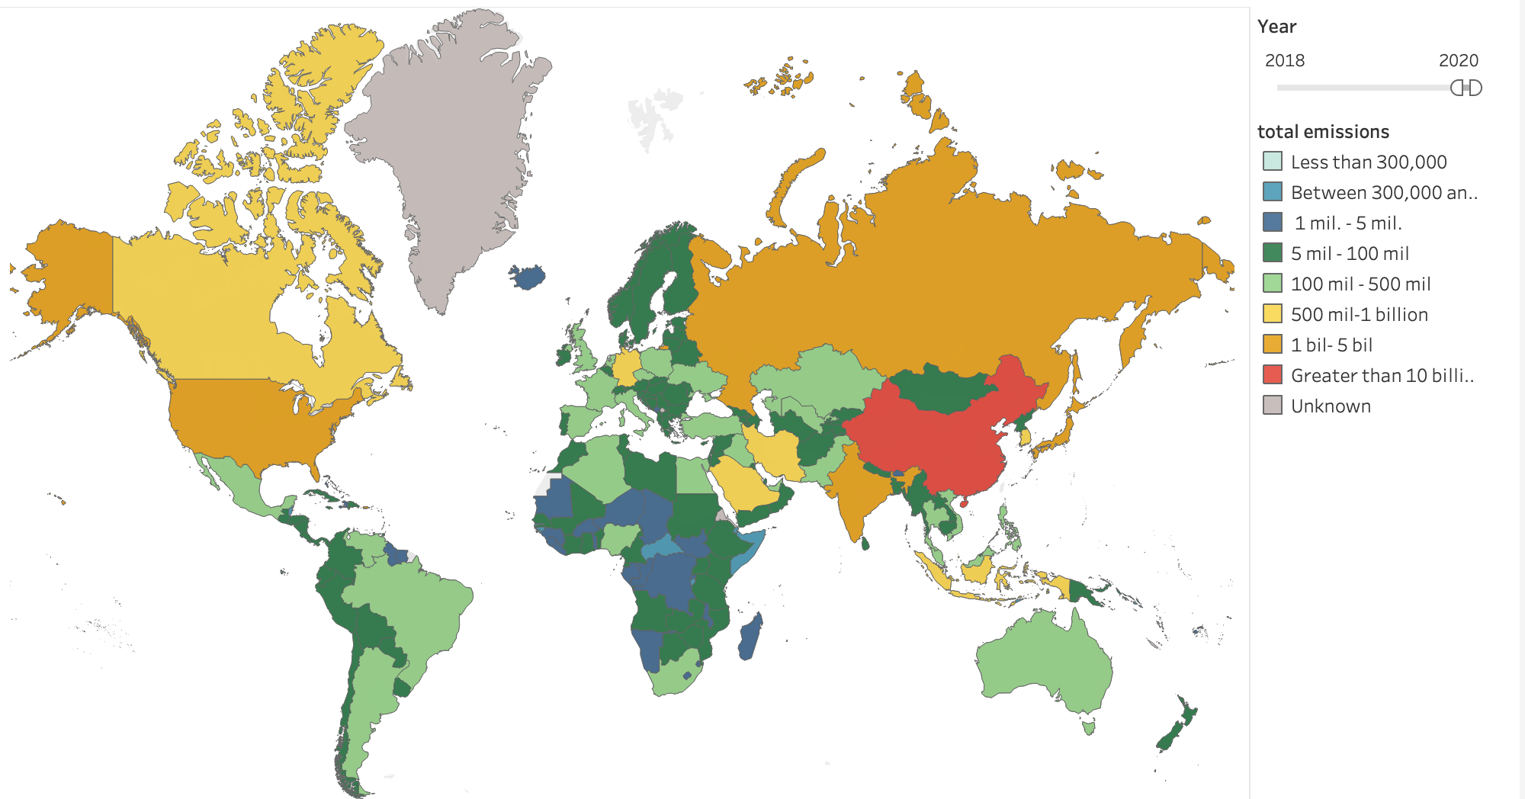
The United States, Russia, India, and China are currently the greatest producers of CO2 emissions.

Slide 6
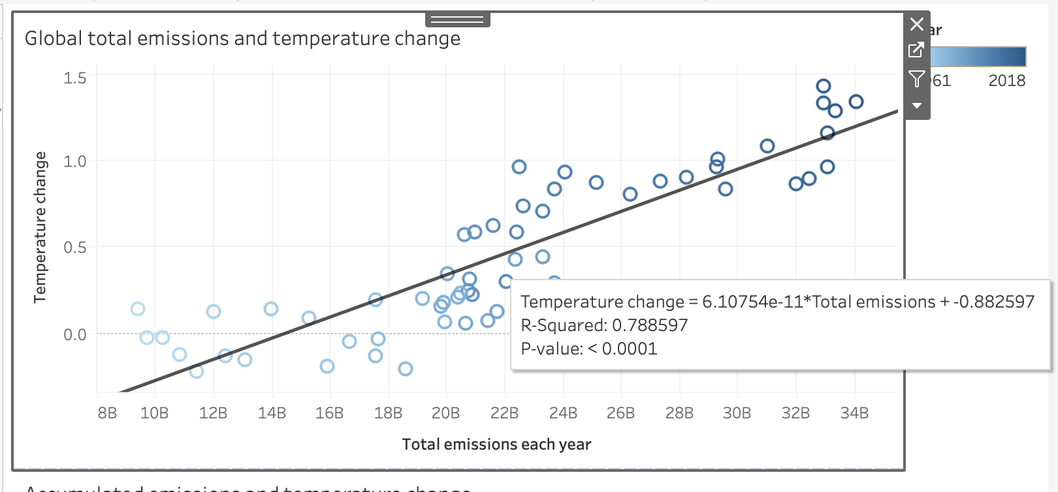
Total annual emissions are highly correlated to temperature change.

Slide 7
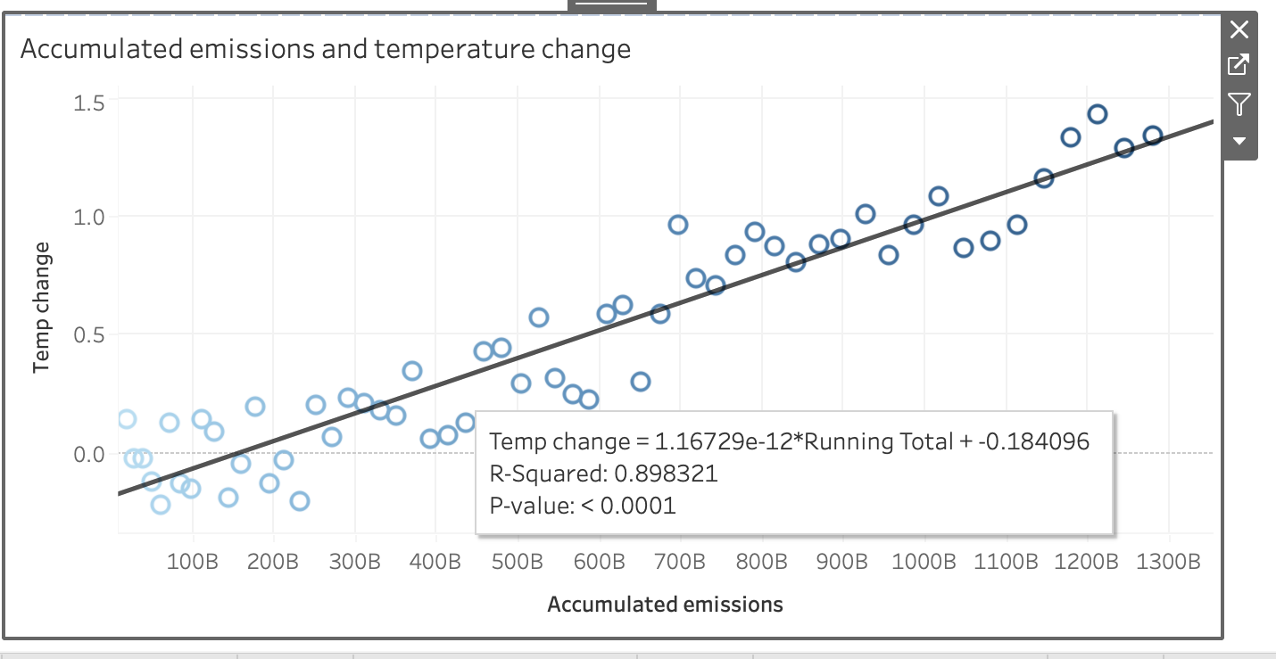
Even more highly correlated is the accumulation of CO2 over the years. This graph shows the cumulative sum of all the CO2 released globally since 1960.

Slide 8
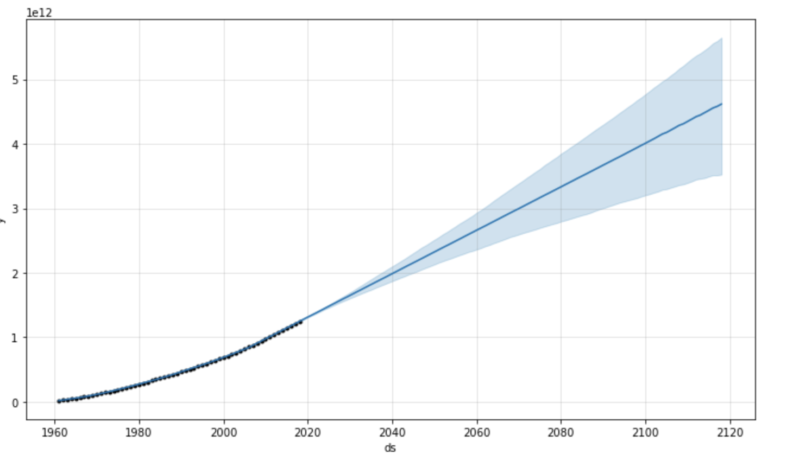
The accumulated emissions are projected to reach nearly 5 trillion tons by 2120 if trends continue. When these projections are passed through a predictive model based on a regression analysis of the relation between temperature change and accumulated emissions, we find that projected temperatures for the early 2100s exceed 5 degrees Celsius of warming.

Slide 9
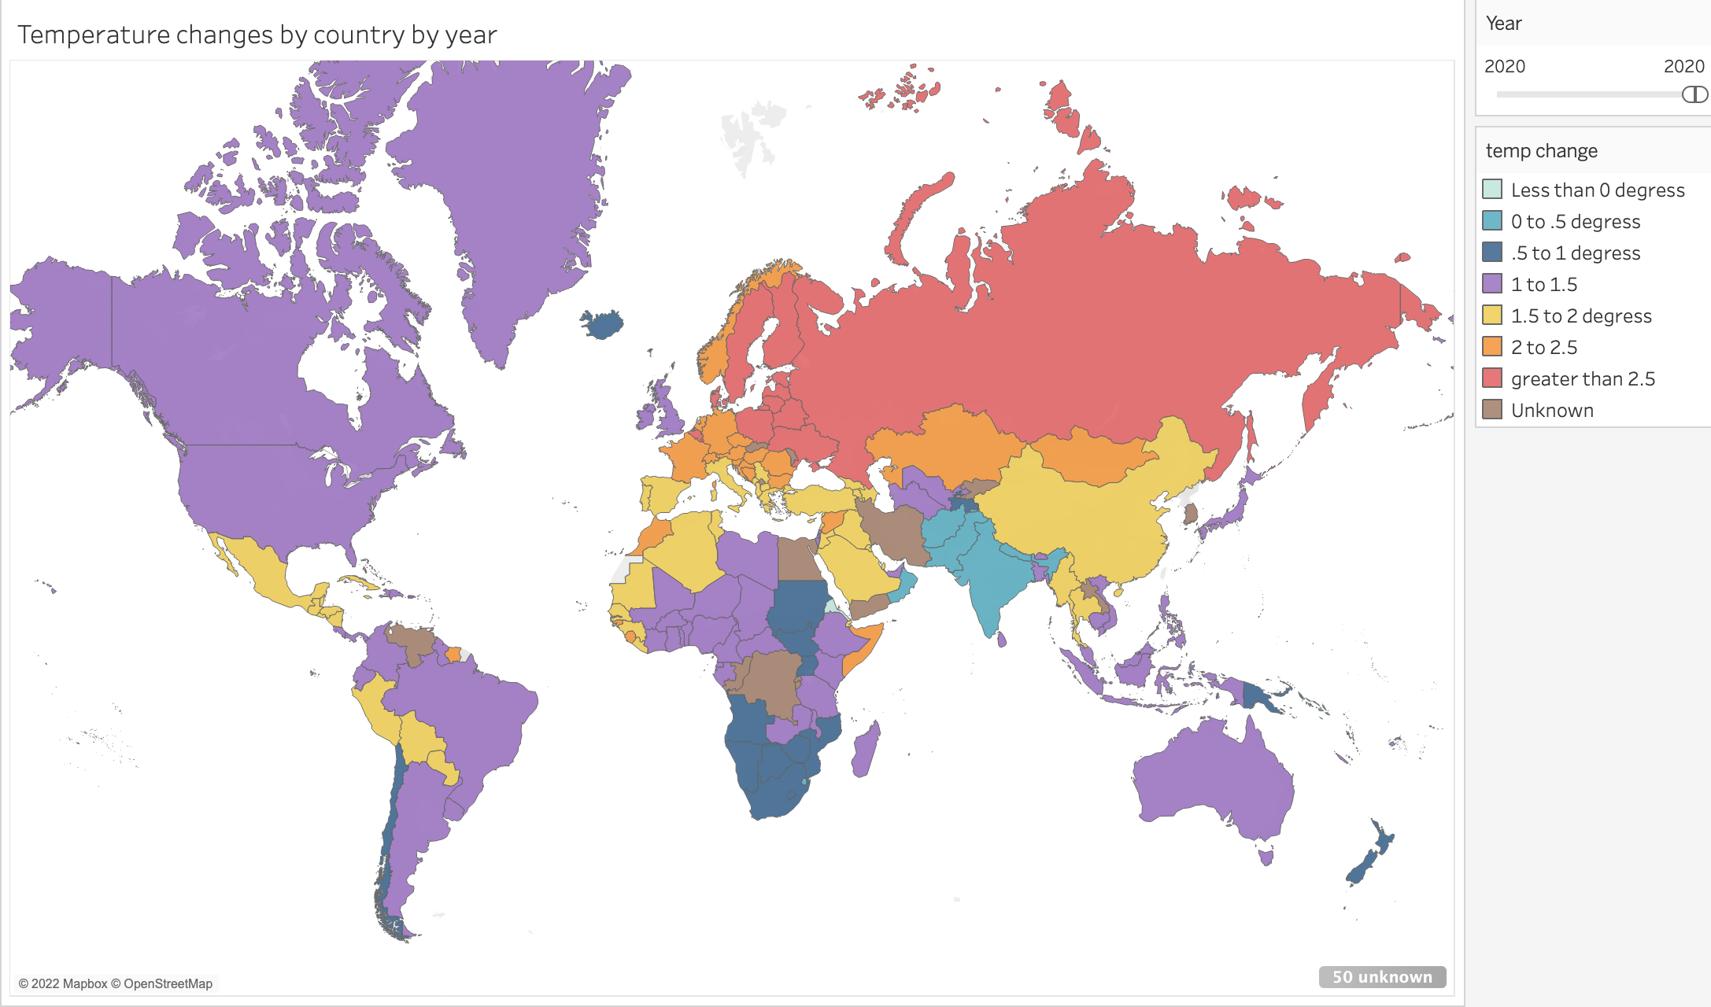
Conclusions: The world must rapidly reduce the amount of CO2 emissions. The burden of the transition should fall primarily on wealthy and middle-income countries, because they produce the vast majority emissions.
Image: temperature difference from the norm in degrees Celsius in 2020

